Slide 1
Welcome to my class ,
my dear students.

Slide 2
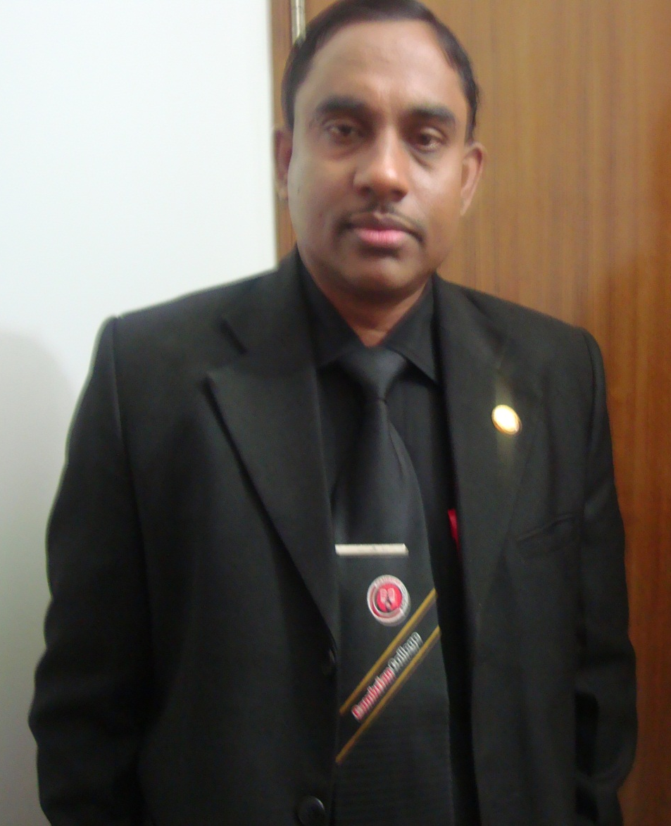
Identity
Md Hasan Hafizur Rahman
Senior Lecturer
Department of English
Cambrian School & College
Dhaka.
Cell-01717220115
Class-8
English First Paper

Slide 3
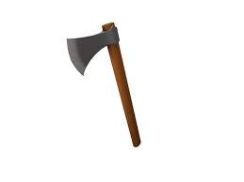
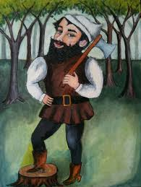

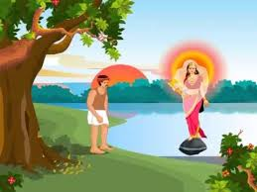

Slide 4
Let us see, what is our
today’s lesson?
An Honest Wood Cutter/
Honesty is the best policy
Chapter: Writing Part

Slide 5
Learning outcomes
After studied this lesson, students will be able to-
tell a story
ask and answer questions
write a story.

Slide 6
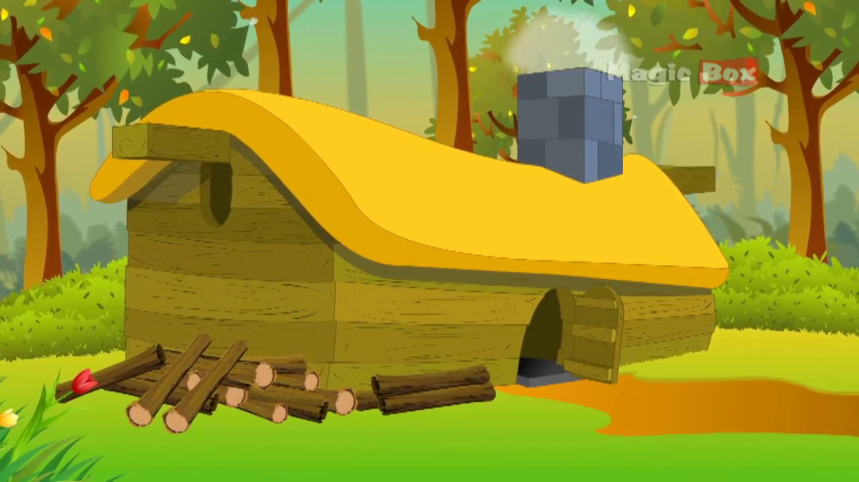
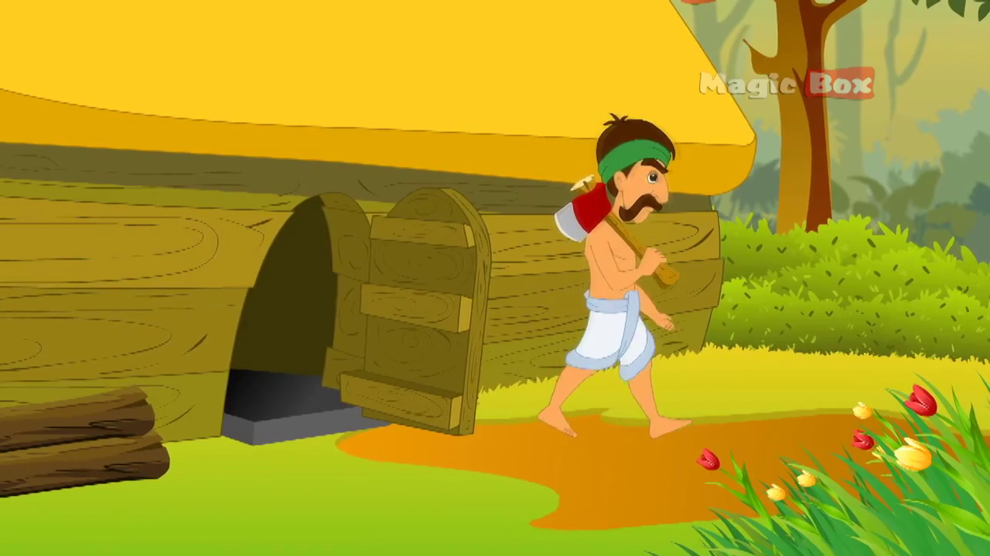
Once there lived an honest wood cutter in a wood.

Slide 7
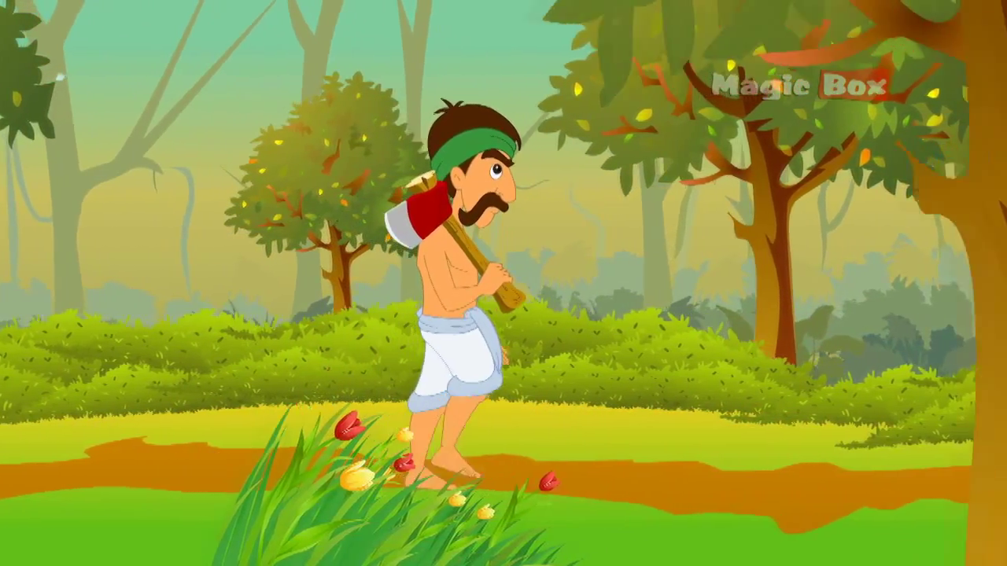
He used to cut wood to support his family by selling it in the market.

Slide 8
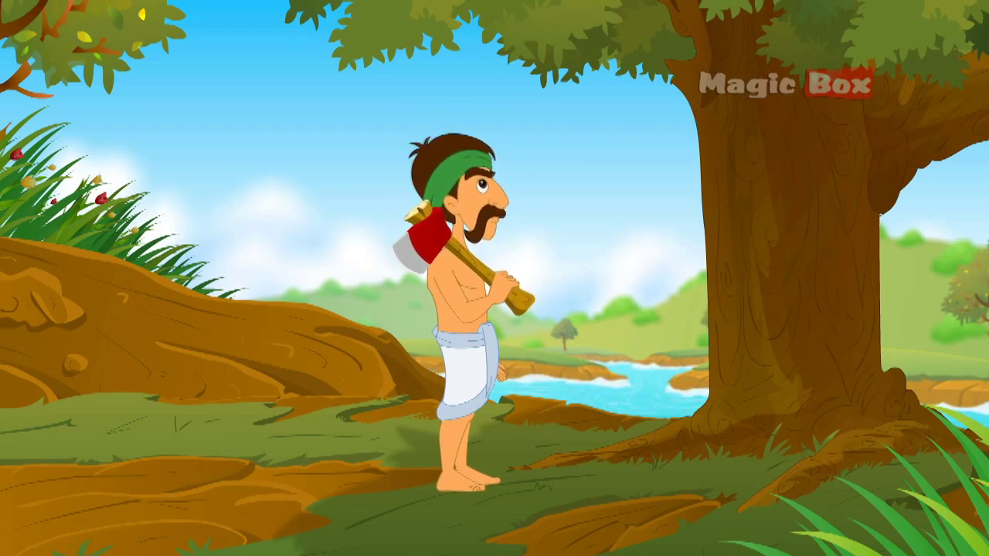
One day he went to the wood as
usual by the side of a river.

Slide 9
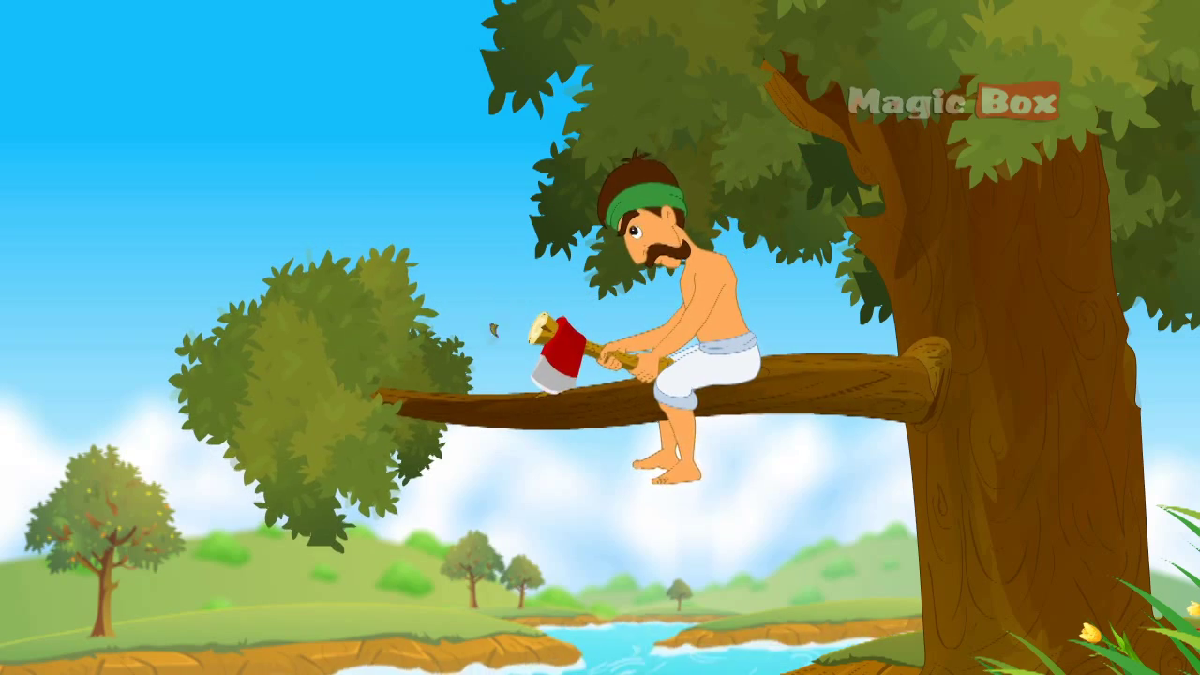
He climbed up a tree and
began to cut a branch of the tree.

Slide 10

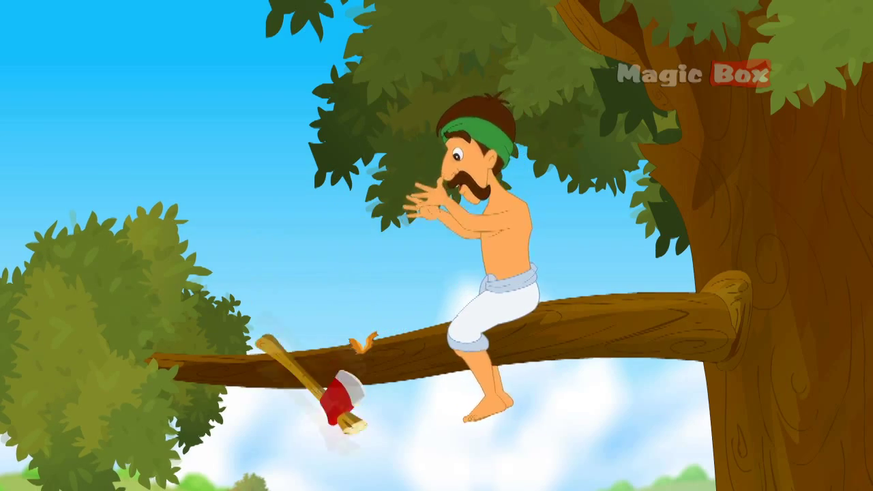
Suddenly his axe slipped off
his hand and fell into the river.

Slide 11
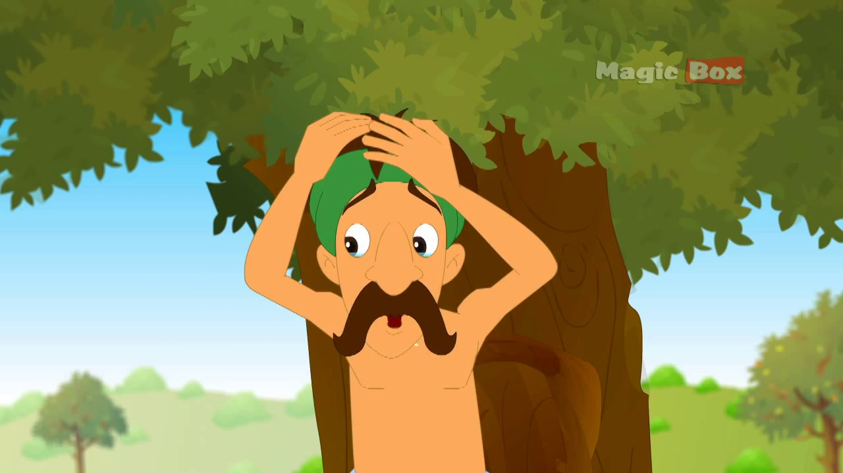
“Oh! My god. What happened?”
Cried out the wood cutter.

Slide 12
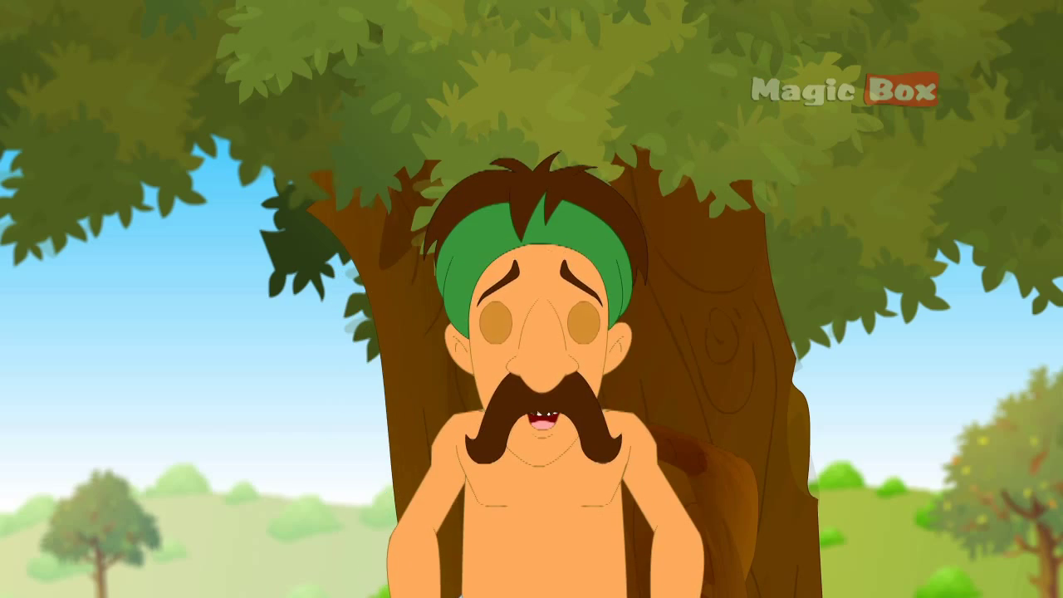
He became very sad and began to cry like a child.

Slide 13
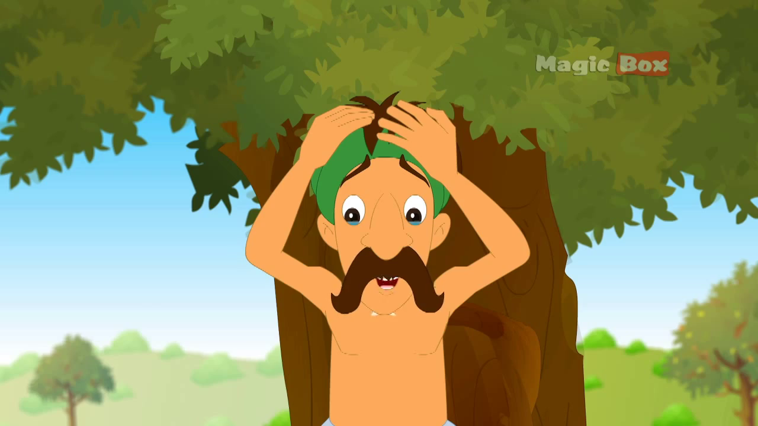
He told himself how will I cut wood and what will happen to my family? I have no another axe and I have no ability to buy a new axe.

Slide 14
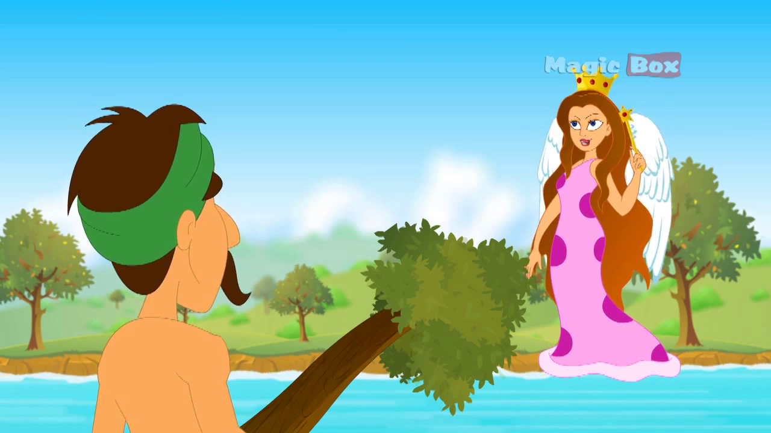
Just at that time a fairy appeared in front of him.

Slide 15
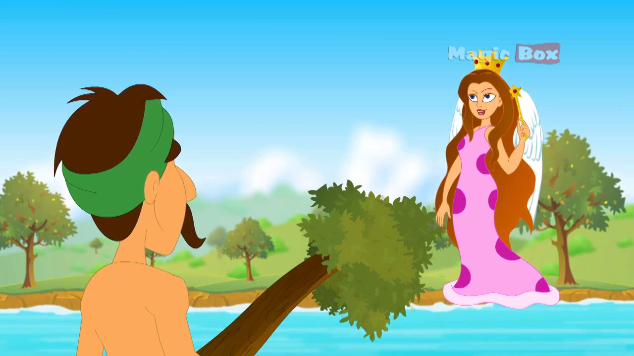
The fairy asked him,” Why are you crying?”

Slide 16
The wood cutter said, “O fairy, Do you want to hear me?” “Yes “ said the fairy.

Slide 17
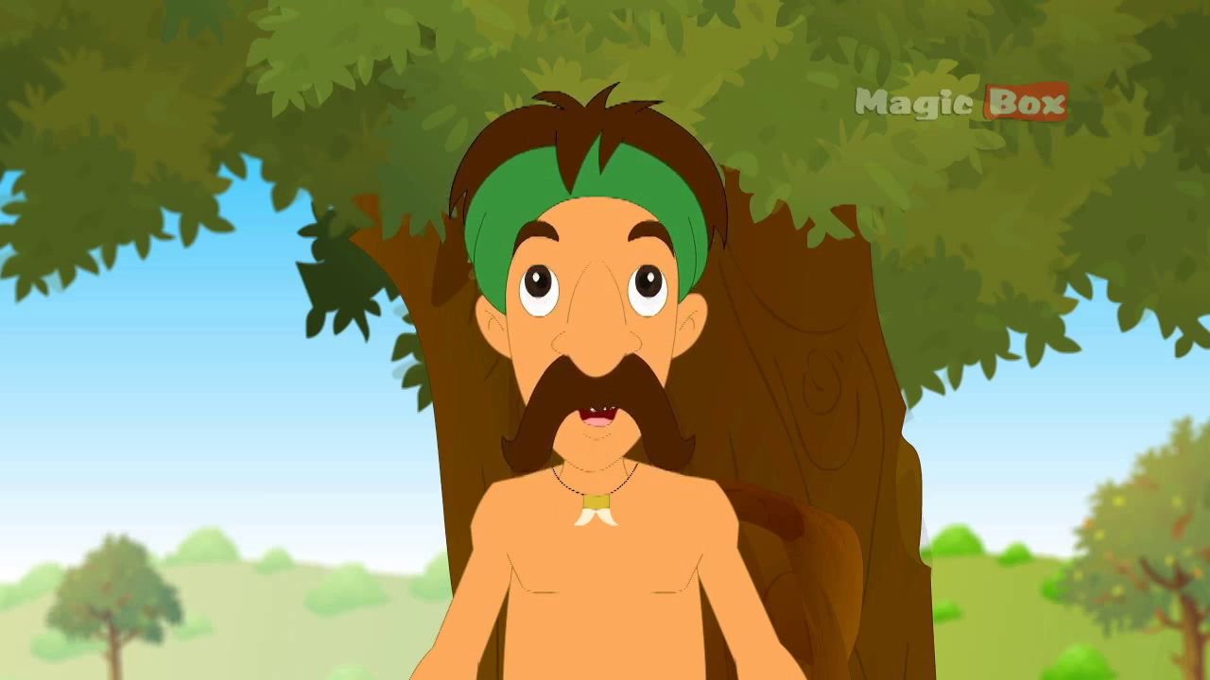
The wood cutter told her the matter.

Slide 18
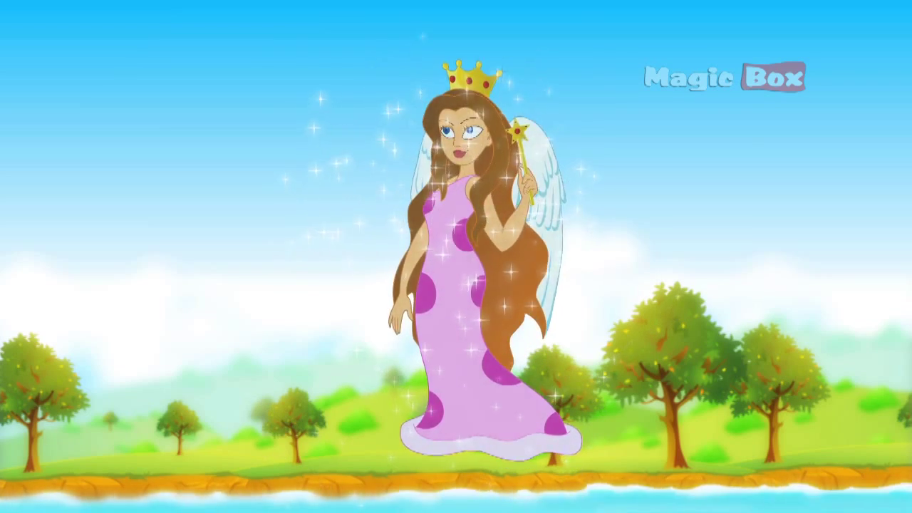
Hearing the wood cutter, The fairy told him not to be worried. She then disappeared.

Slide 19
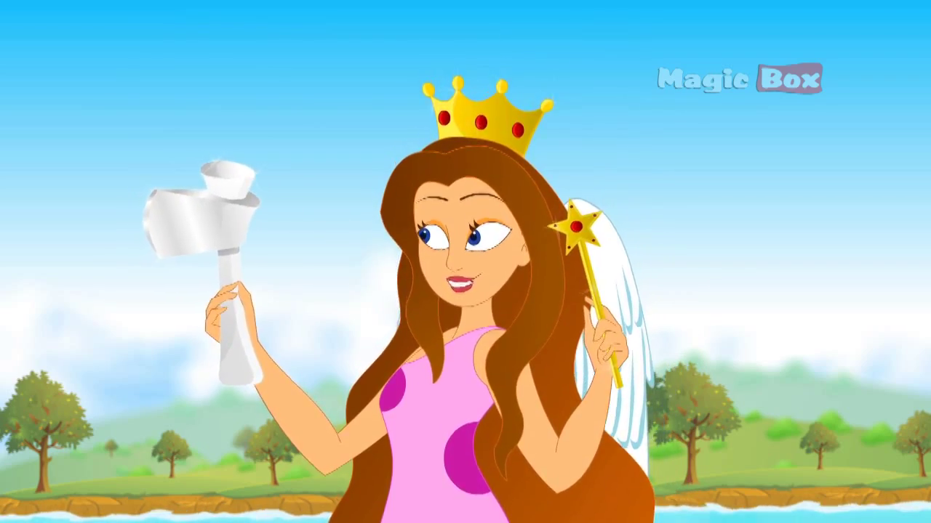
After a while she appeared from the river with a silver axe and asked him, “ Is it your axe?”

Slide 20
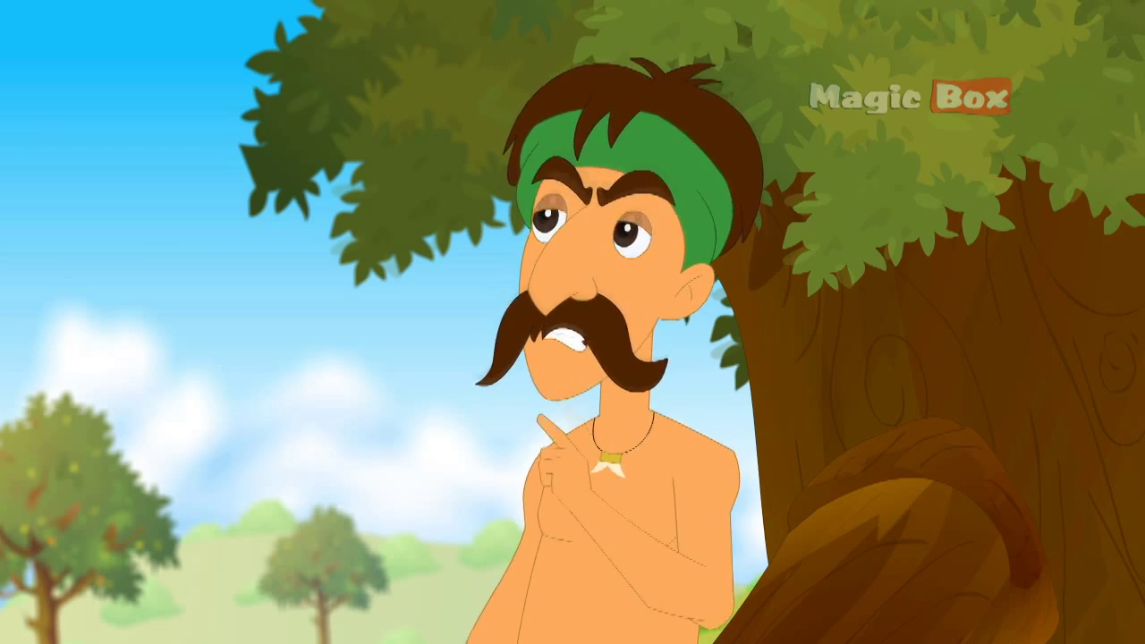
In reply the wood cutter said, “No, it is not mine.”

Slide 21
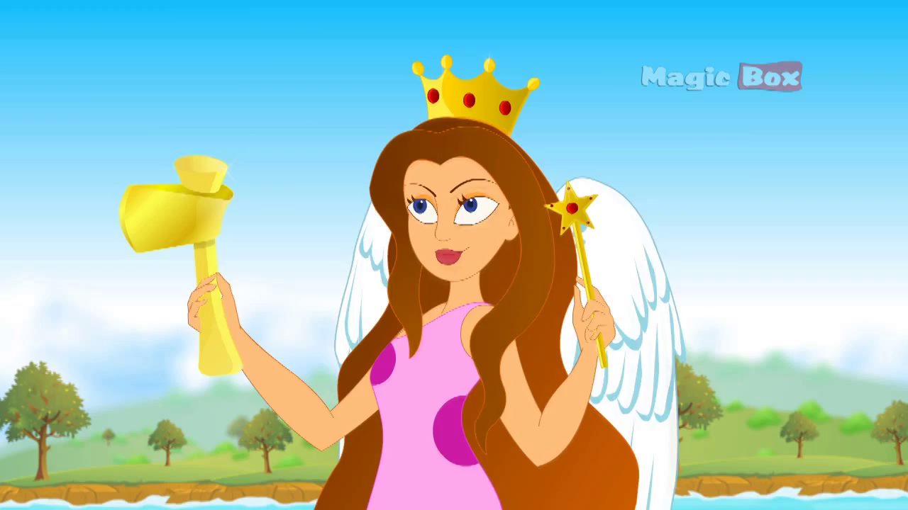
Then the fairy disappeared again and came back with a golden axe. She asked the same to the wood cutter. But as the wood cutter was an honest man, he answered that it was not his axe. His original axe was an iron axe.

Slide 22
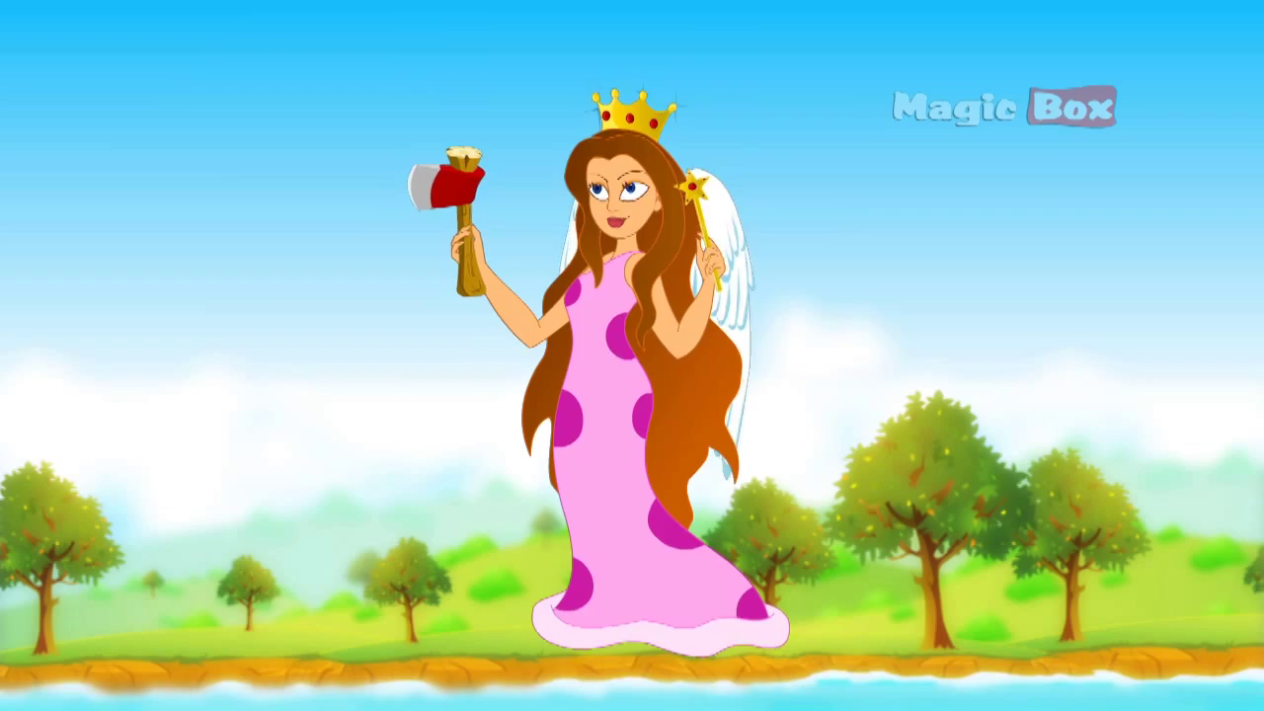
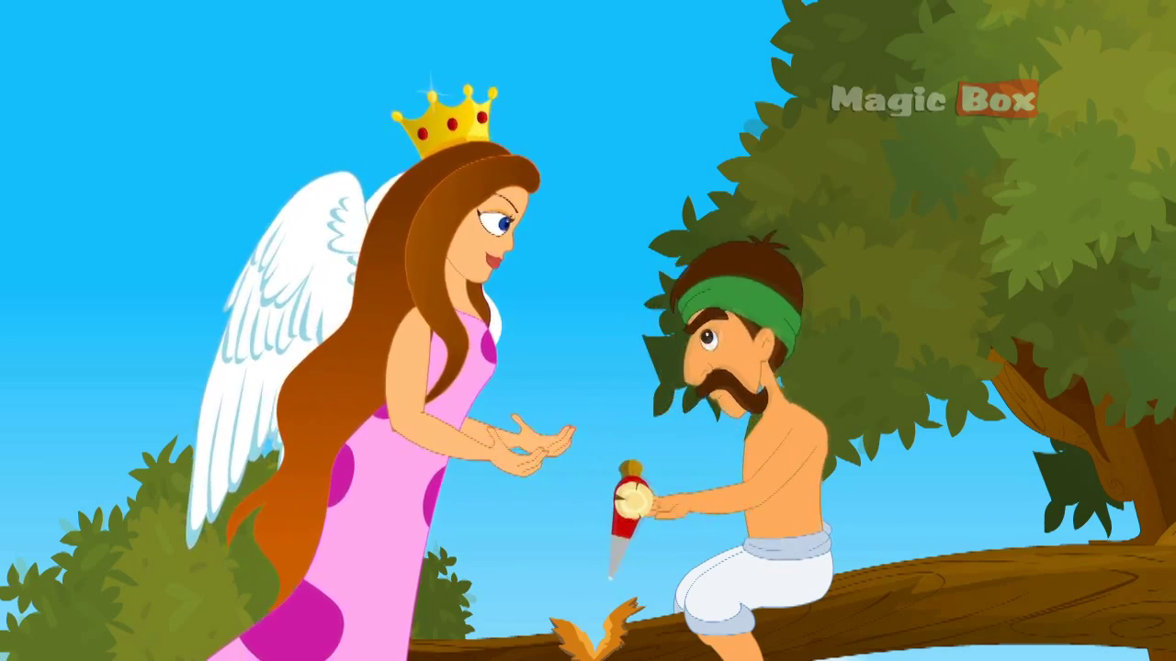
After a while the fairy came back with the iron axe and gave it to the wood cutter. He became very pleased with the fairy and thanked her.

Slide 23
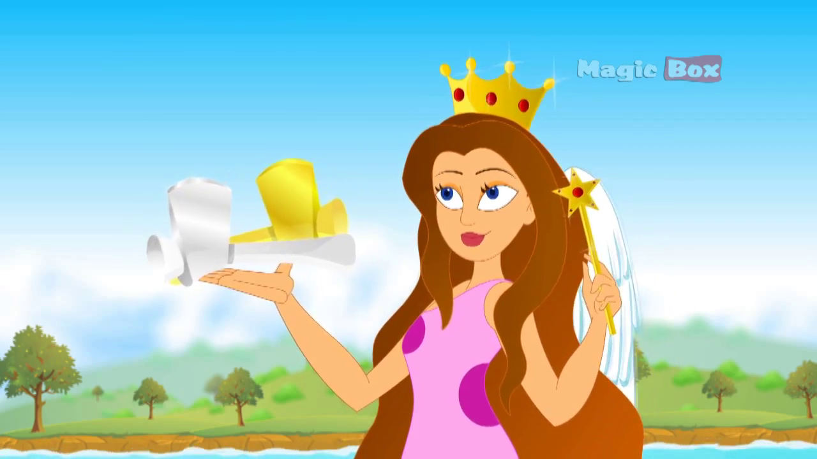
The fairy told the wood cutter that she liked to give him all the three axes because he told the truth.

Slide 24
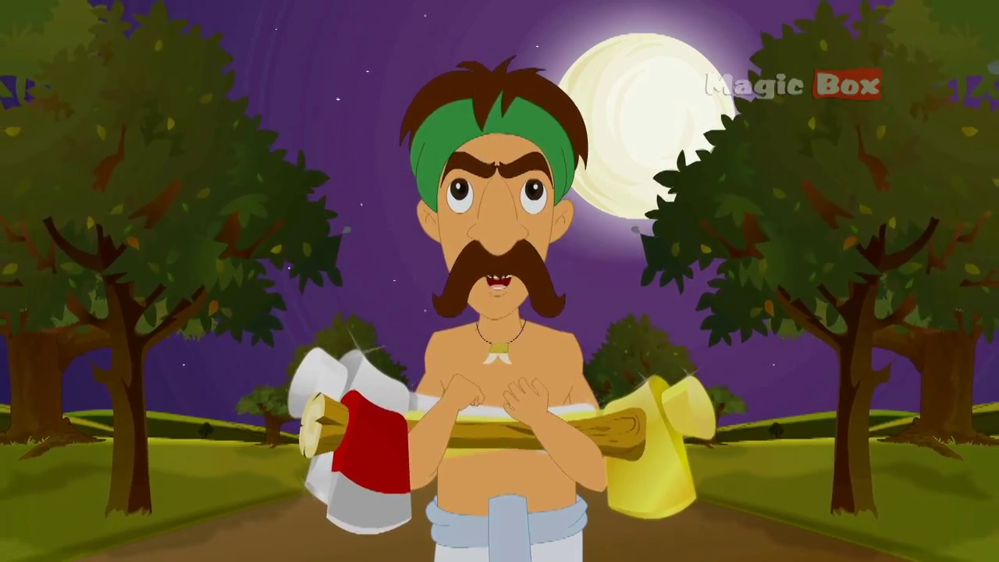
Then the fairy gave him the three axes and the wood cutter became pleased with the fairy and thanked her again.

Slide 25
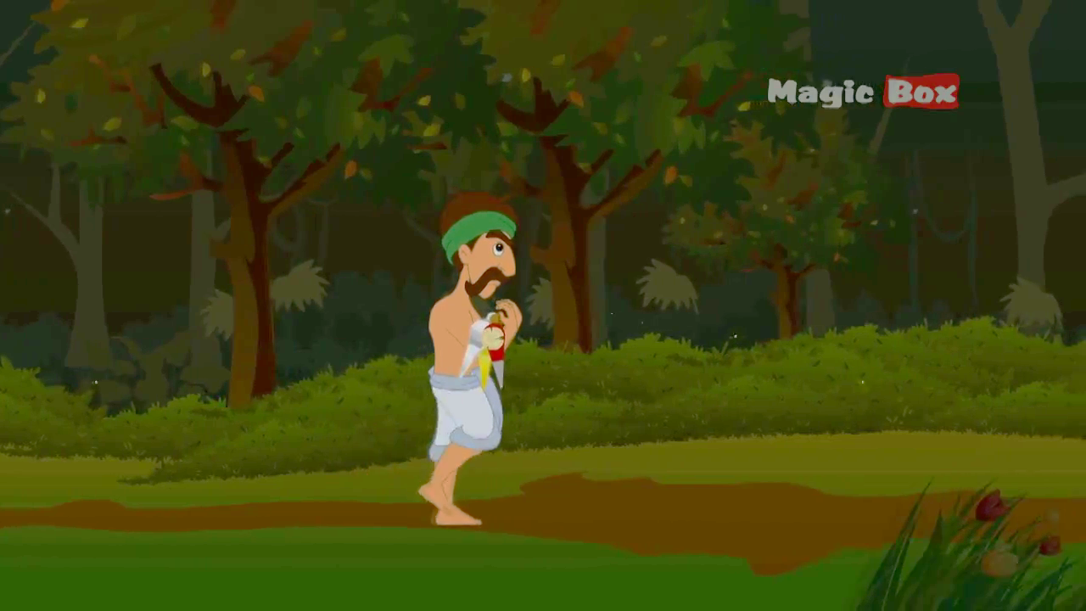
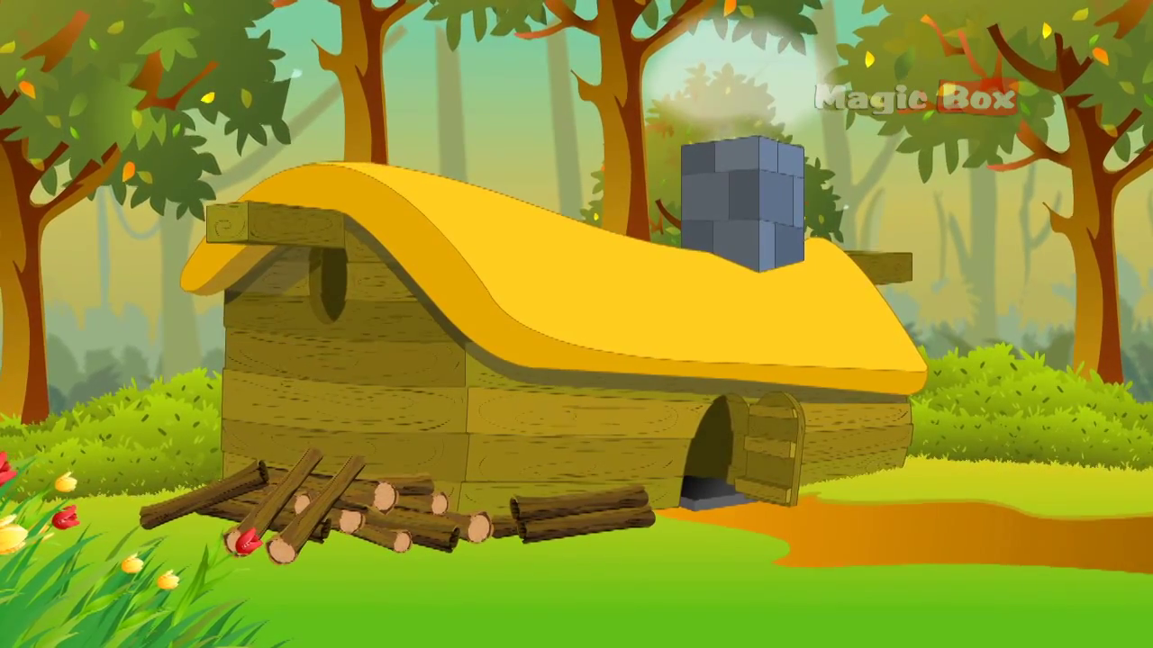
The wood cutter came back home delightfully.
He was awarded for his honesty.

Slide 26
Let us enjoy the video

Slide 27
Group Work
Make a logical assemble of the words village, axe, fairy, wood cutter, river, honest, pleased to write a story in a group.

Slide 28
Evaluation
What is the story about?
Where did the wood cutter live?
How did he support his family?
What happened while cutting wood one day?
Why was he awarded by a fairy?

Slide 29
Home Task
Write a story on “Honesty is the best policy.

Slide 30
Moral
Honesty is always rewarded.

Slide 31
Thank You

